Slide 1
CHAPTER 2
LIMITS AND CONTINUITY

Slide 2
CONTENTS
2.1. The Tangent & Velocity Problems
2.2. The Limit of a Function
2.3. Calculating Limits using the Limit Law
2.4. Continuity
2.5. Limits involving Infinity
2.6. Limits of Sequences

Slide 3
2.6. LIMITS OF SEQUENCES
2.6.1. Limits of Sequences
2.6.2. Limit Laws
2.6.3. Monotonic Sequence Theorem

Slide 4
2.6.1 Limits of Sequences
A sequence is a list of numbers written in a definite order:
a₁, a₂, a₃, …, a_{n} , …
a₁ is the first term, a₂ is the second term,… a_{n} is the n^{th} term
A sequence may be viewed as a function defined on the set of positive integer f(n)= a_{n} .
We use the following notations for a sequence:
{a₁, a₂, a₃, …}, {a_{n} } or

Slide 5
Example. A sequence may be described as above or by a defining formula, or by writing out its terms

Slide 6
Example. A sequence may be described in other ways:
{p_{n}}, where p_{n} is the world population in year n
Let a_{n} be the digit in the n^{th} decimal place of the number e then: {a_{n}}={7,1,8,2,8,4,5,…}
The Fibonacci sequence {f_{n}} is defined recursively by:
f₁ = 1 f₂ = 1 f_{n} = f_{n-1} + f_{n-2} n ≥ 3
{f_{n}} = {1,1,2,3,5,8,13,21,…}

Slide 7
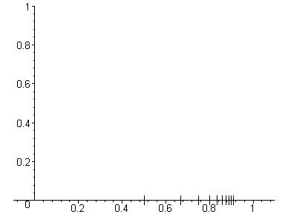
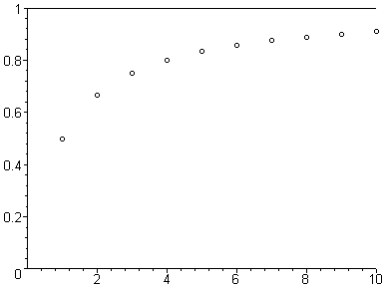
We can plot a sequence horizontally or vertically as follows
a_{n}
a₁
a₂
It seems from the graphs that a_{n} approaches 1 as n becomes large. We say that the limit of {a_{n}}is 1
In general we have

Slide 8
Definition. We say that the limit of a sequence {a_{n}} is equal to L if
we can make the values of a_{n} as close to L as we like by taking n sufficiently large. We also write
exists we say that the sequence is convergent, otherwise it is divergent
Besides the finite limit, we also define
if a_{n} becomes arbitrary large as n is sufficiently large.
We say that {a_{n}} diverges to ∞
Finally, we define

Slide 9
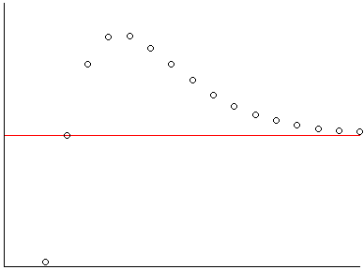
Following is the graph of a sequence {a_{n}} that converges to the limit L
L
It looks as if the points belong to the graph of a function f(x)
that approaches the limit L as x approaches ∞

Slide 10
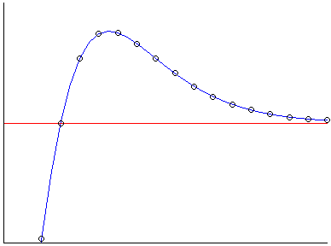
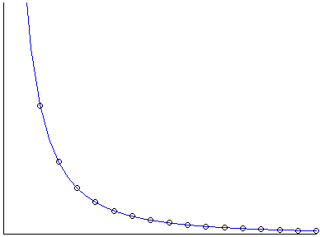
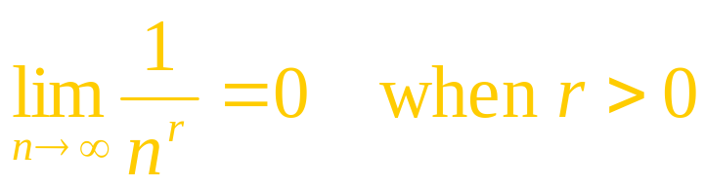
Theorem1.
and f(n)=a_{n} for n ∈N then
As an application, since
we have

Slide 11
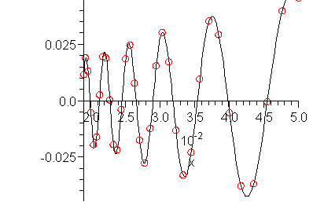
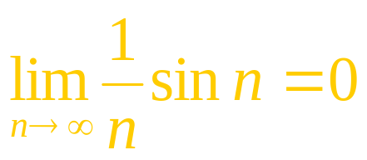
Theorem2. Let {a_{n}} be a sequence convergent to a, and f be a function such that
Put b_{n} = f(a_{n}), n ∈N. Then
As an application, since
we have

Slide 12
2.6.2 Limit Laws
Limit Laws. If {a_{n}} and {b_{n}} are convergent sequences and c, d are constants, then

Slide 13
The Squeeze Theorem also holds for sequences
The Squeeze Theorem.
If a_{n} ≤ b_{n} ≤ c_{n} for n ≥ N and
As a consequence, since -|a_{n} | ≤ a_{n} ≤ |a_{n} | we have
Theorem 2.

Slide 14
Example. Find
Solution. We use the same method as in finding the limit of a rational function

Slide 15
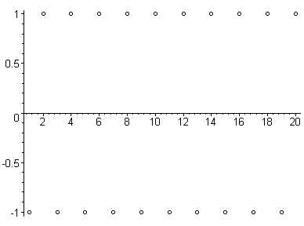
Example. Is the sequence a_{n} = (-1)^{n} convergent or divergent?
Solution. There are infinitely many terms equal to 1 (when n is even) and
infinitely many terms equal to –1 (when n is odd) .
Therefore the sequence is divergent

Slide 16
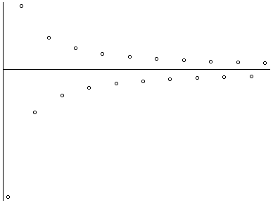
Example. Find
Solution. We have
Therefore it follows from Theorem2 that

Slide 17
Example. Discuss the convergence of the sequence
a_{n} = n!/n^{n}
Solution. We cannot apply Theorem1 because there is no corresponding function. However we have
Hence it follows from the Squeeze Theorem that

Slide 18
Example. For what values of r is the sequence {r ^{n}} convergent?
Solution. We know from the properties of exponential functions that
Hence it follows from Theorem1 that
Moreover

Slide 19
If –1< r < 0 then 0 < |r| < 1. Hence it follows that
Therefore Theorem2 gives
Finally if r ≤ –1 then there are infinitely many terms ≥ 1 (n even)
and infinitely many terms ≤ –1 (n odd).
It follows that the sequence is divergent.
In summary we have
Theorem 2. The sequence {r ^{n}} is convergent if and only if –1< r ≤ 1. Moreover

Slide 20
2.6.3 Monotonic Bounded Sequences
Definition. A sequence {a_{n}} is increasing if a_{n} < a_{n+1} for all n ≥ 1,
and decreasing if a_{n} > a_{n+1} for all n ≥ 1.
It is said to be monotonic if it is either increasing or decreasing
Note that an increasing sequence may be written as:
a₁ < a₂ < a₃ < … < a_{n} < a_{n+1} < …
and a decreasing sequence may be written as:
a₁ > a₂ > a₃ > … > a_{n} > a_{n+1} > …

Slide 21
Example. The sequence {3/(n+5)} is decreasing because
for all n ≥ 1

Slide 22
Example. Show that the sequence is decreasing
Solution1. We must show that a_{n+1} < a_{n}, i.e.
(n+1)(n²+1) < n[(n+1)²+1]
n³ + n² + n + 1 < n³ + 2n² + 2n
1 < n² + n
The last inequality is true because n ≥ 1. Hence the sequence {n/(n²+1)} is decreasing

Slide 23
Solution2. Consider the function
We have
Hence the function is decreasing on (1, ∞) and so
f(n) > f(n+1)
Therefore {a_{n}} is decreasing

Slide 24
Definition. A sequence {a_{n}} is bounded above if there is a number M such that a_{n} ≤ M for all n ≥ 1.
It is bounded below if there is a number m such that a_{n} ≥ m for all n ≥ 1.
It is said to be bounded if it is both bounded from above and below
Example. The sequence a_{n}= n is bounded below but not above.
The sequence a_{n}= n/(n+1) is bounded because 0 < a_{n}< 1 for all n

Slide 25
Note. A convergent sequence {a_{n}} is bounded since the value of a_{n} is arbitrary closed to L for n large. We have L – 1 < n < L + 1 for n > N.
Then we can choose M as the largest among L+1 and |a₁ |, |a₂ |, … , |a_{N} |
Similarly m may be chosen as the smallest among L – 1 and -|a₁ |, -|a₂ |, … , -|a_{N} |.
The converse is not true, e.g. the sequence {(-1)^{n}} is bounded but not convergent. However we have
Monotonic Sequence Theorem. Every bounded above (below) increasing (decreasing) sequence is convergent

Slide 26
Example. Investigate the convergence of the sequence defined by
Solution. We have
The sequence seems to be increasing and bounded above by 6. We will prove this by induction.
First of all, a₁ = 2 < 6. Assume that a_{n} < 6. Then
Hence a_{n} < 6 for all n.

Slide 27
a_{n} < 6 for all n
It follows that
i.e. {a_{n} }is an increasing sequence.
Therefore it follows from the Monotonic Sequence Theorem that {a_{n} }converges to a limit L.
It is clear that a_{n+1} also converges to L. Hence

Slide 28
2.6.4 The Existence of Exponential Functions
Recall that f(x)=2^{x} is defined on R so that f is increasing
For example to define we use the sequences of rational numbers:
Since f is increasing, we have

Slide 29
Therefore these sequences converge to the limits L ≤ L’ respectively by the Monotonic Sequence Theorem.
Note that b_{n} – a_{n} is a decreasing sequence and
We also have

Slide 30
Assume that
For any m ∈ N, if n is sufficiently large, then we have
Therefore
Hence
if m > 1 / c:
This is a contradiction.

Slide 31
This contradiction shows that L = L’
and the common limits are precisely
Note that the common limits do not depend on the choice of the sequences { a_{n} } and {b_{n}}
Finally the values f(x)=2^{x} for any real number x is defined in a similar manner.
It is clear that f is an increasing function on R
Moreover if {x_{n}} is a monotonic sequence that converges to x, then f(x_{n}) converges to f(x)
In other words, f is continuous on R

